Slide 1
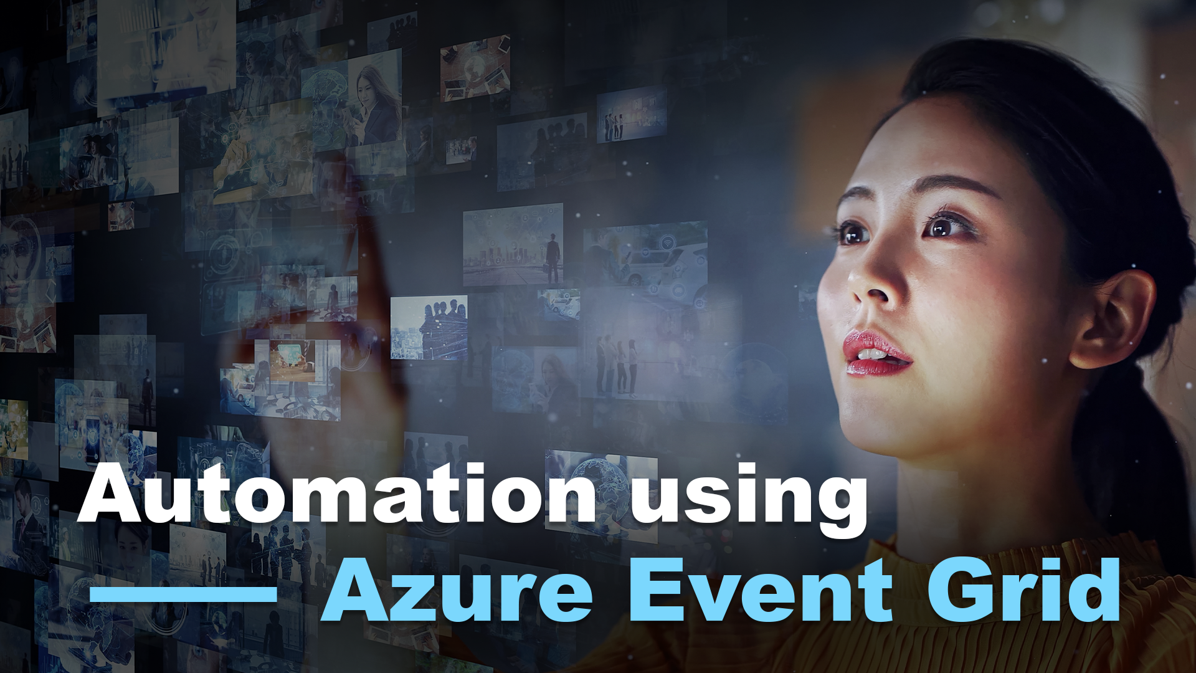

Slide 2




Slide 3




Upcoming Events
Notes:
VSLive – March 19-24
Orlando Code Camp – March 25
InflectraCon – April 19-21
Serverless Architecture Conference – April 24-27

Slide 4


Upcoming Events
Notes:
Global AI Bootcamp – March 2 -4; DC or Dallas
Global Azure Bootcamp – May 13

Slide 5

I’m Hiring

Slide 6



Slide 8







Who is Chad Green?
chadgreen@chadgreen.com
TaleLearnCode
ChadGreen.com
ChadGreen & TaleLearnCode
ChadwickEGreen

Slide 9
User Story
As a community directory, I want thumbnails generated of high-resolution images of residents I upload to their profile so that the application can use the small image for quicker display within the application.
Acceptance Criteria
Thumbnails should be generated automatically with no user intervention
Thumbnails should be located in a known location so they can be easily referenced
Architecture Analysis
Build a platform-level utility that can be used by the different applications
Utility to be configurable per application
Source images could come from multiple locations
Outputted image dimensions should be configurable
Outputted images should have configured prefix/suffixes added

Slide 10






Initial Architecture
Blob Storage Account
(Source)
SixLabors.ImageSharp
Blob Trigger
Function Handler
Activity Log
Tenant Database
Application Insights
Blob Storage Account
(Destination)

Slide 11
User Story
As a community directory, I want thumbnails generated of high-resolution images of residents I upload to their profile so that the application can use the small image for quicker display within the application.
Acceptance Criteria
Thumbnails should be generated automatically with no user intervention
Thumbnails should be located in a known location so they can be easily referenced
Architecture Analysis
Build a platform-level utility that can be used by the different applications
Utility to be configurable per application
Source images could come from multiple locations
Outputted image dimensions should be configurable
Outputted images should have configured prefix/suffixes added
Provide a rest endpoint that could be called when necessary

Slide 12
Initial Architecture
Blob Storage Account
(Source)
HTTP Trigger
SixLabors.ImageSharp
Blob Trigger
Function Handler
Activity Log
Tenant Database
Application Insights
Blob Storage Account
(Destination)

Slide 13
Initial Architecture Problems
Blob Storage Account
(Source)
Blob Storage Account
(Source)
Blob Storage Account
(Source)
Blob Trigger
Blob Trigger
Blob Trigger
Blob Storage Account
(Source)
Blob Storage Account
(Source)
Blob Trigger
Blob Trigger

Slide 14
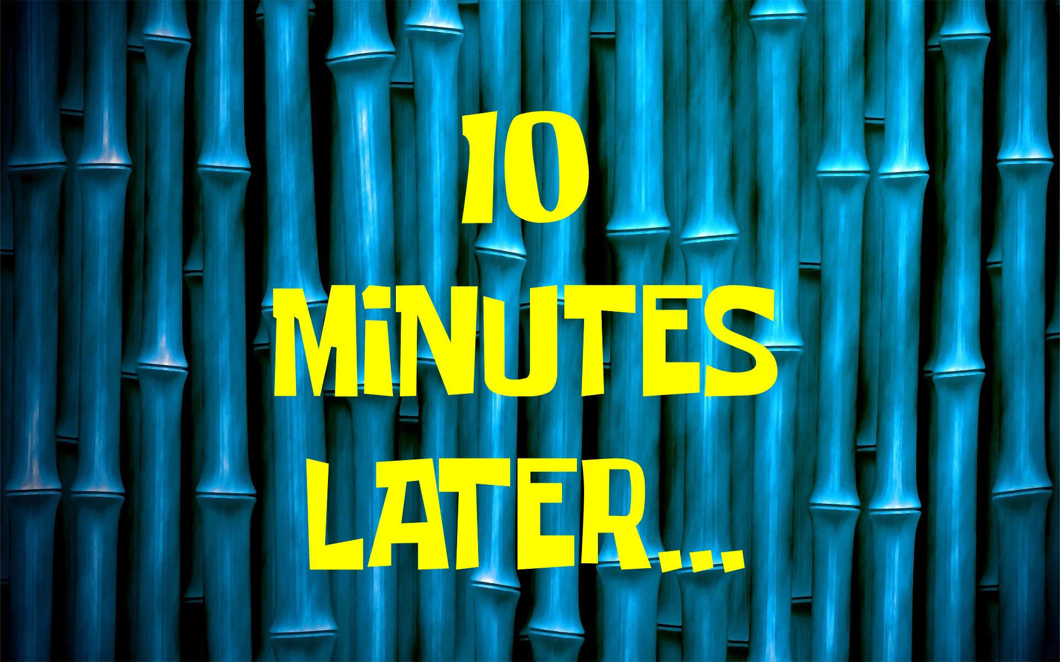
Initial Architecture Problems
Notes:
Minimizing latency: if your function app is on the Consumption plan, there can be up to a 10-minute delay in processing new blobs if a function app has gone idle. To avoid this latency, you can switch to an App Service plan with Always On enabled. You can also use an Event Grid trigger with your Blob storage account.

Slide 15
Azure Event Grid
Automation Using Event Grid

Slide 16

Azure Event Grid
Highly scalable, serverless event broker
Events delivered to subscriber destinations
Event source can be other applications, SaaS services, and Azure services
Notes:
Event Grid is a highly scalable, serverless event broker that you can use to integrate applications using events.
Events are delivered by Event Grid to subscriber destinations such as applications, Azure services, or any endpoint to which Event Grid has network access.
The source of those events can be other applications, SaaS services and Azure services.

Slide 17















Azure Event Grid
Event Sources
Serverless Code
Azure Blob Storage
Functions
Azure Resource Groups
Azure Subscriptions
Workflow and Integration
Service Bus
Logic Apps
Azure Event Hubs
Event Handlers
Azure IoT Hub
Buffering and Competing Consumers
Azure IoT Hub
Event Hubs
Storage
Queues
Azure Maps
Azure Container Registry
Azure Policy
Other Services
And Applications
Hybrid Connections
(WebSockets)
Webhooks
(anything)
Azure
Automation
Azure Machine Learning
Notes:
The event sources and event handlers or destinations are summarized in the following diagram.
This image shows how Event Grid connects sources and handlers, and isn't a comprehensive list of supported integrations. For a list of all supported event sources, see the following section.

Slide 18
Azure Event Grid Concepts
Events – What happened
Event Sources – Where the event happened
Topics – Endpoint where publishers send events
Event Subscriptions – Endpoint to route events
Event Handlers – App or service reacting to an event
Notes:
There are five concepts in Azure Event Grid that let you get going:
Events - What happened.
Event sources - Where the event took place.
Topics - The endpoint where publishers send events.
Event subscriptions - The endpoint or built-in mechanism to route events, sometimes to more than one handler. Subscriptions are also used by handlers to intelligently filter incoming events.
Event handlers - The app or service reacting to the event.

Slide 19
Azure Event Grid Capabilities
Simplicity
Advanced Filtering
Fan-Out
Reliability
Pay-Per-Event
High Throughput
Built-In Events
Custom Events
Notes:
Here are some of the key features of Azure Event Grid:
Simplicity - Point and click to aim events from your Azure resource to any event handler or endpoint.
Advanced filtering - Filter on event type or event publish path to make sure event handlers only receive relevant events.
Fan-out - Subscribe several endpoints to the same event to send copies of the event to as many places as needed.
Reliability - 24-hour retry with exponential backoff to make sure events are delivered.
Pay-per-event - Pay only for the amount you use Event Grid.
High throughput - Build high-volume workloads on Event Grid.
Built-in Events - Get up and running quickly with resource-defined built-in events.
Custom Events - Use Event Grid to route, filter, and reliably deliver custom events in your app.

Slide 20
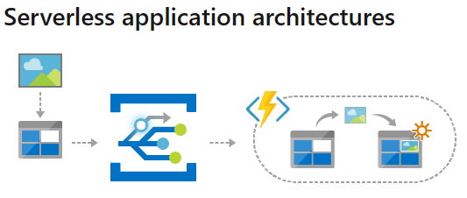
Azure Event Grid Possibilities
Notes:
Event Grid connects data sources and event handlers. For example, use Event Grid to trigger a serverless function that analyzes images when added to a blob storage container.

Slide 21
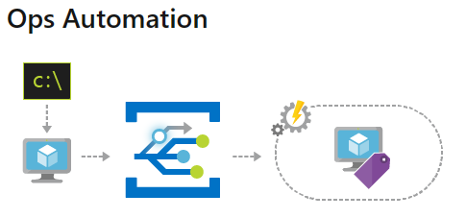
Azure Event Grid Possibilities
Notes:
Event Grid allows you to speed automation and simplify policy enforcement. For example, use Event Grid to notify Azure Automation when a virtual machine or database in Azure SQL is created. Use the events to automatically check that service configurations are compliant, put metadata into operations tools, tag virtual machines, or file work items.

Slide 22
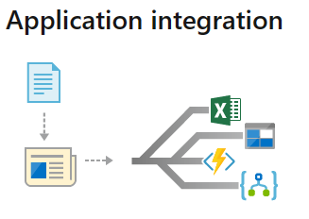
Azure Event Grid Possibilities
Notes:
Event Grid connects your app with other services. For example, create a custom topic to send your app's event data to Event Grid, and take advantage of its reliable delivery, advanced routing, and direct integration with Azure. Or, you can use Event Grid with Logic Apps to process data anywhere, without writing code.

Slide 23
Delivered Solution
Automation Using Azure Event Grid

Slide 24
Blob Trigger vs Event Grid Trigger
Use Event Grid trigger instead of Blob storage trigger:
Blob storage accounts
High scale
Minimizing latency
Blob delete events
Notes:
The Blob storage trigger starts a function when a new or updated blob is detected. The blob contents are provided as input to the function. The Event Grid trigger has built-in support for blob events and can also be used to start a function when a new or updated blob is detected. When using the Blob storage trigger, you can directly access the content of the new or updated blob. Use Event Grid instead of the Blob storage trigger for the following scenarios:
Blob storage accounts: Blob storage accounts are supported for blob input and output bindings but not for blob triggers. Blob storage triggers require a general-purpose storage account.
High scale: high scale can be loosely defined as containers that have more than 100,000 blobs in them or storage accounts that have more than 100 blob updates per second.
Minimizing latency: if your function app is on the Consumption plan, there can be up to a 10-minute delay in processing new blobs if a function app has gone idle. To avoid this latency, you can switch to an App Service plan with Always On enabled. You can also use an Event Grid trigger with your Blob storage account.
Blob delete events: you cannot handle blob delete events with the Blob Storage trigger

Slide 25
User Story
As a community directory, I want thumbnails generated of high-resolution images of residents I upload to their profile so that the application can use the small image for quicker display within the application.
Acceptance Criteria
Thumbnails should be generated automatically with no user intervention
Thumbnails should be located in a known location so they can be easily referenced
Architecture Analysis
Build a platform-level utility that can be used by the different applications
Utility to be configurable per application
Source images could come from multiple locations
Outputted image dimensions should be configurable
Outputted images should have configured prefix/suffixes added
Provide a rest endpoint that could be called when necessary
When source images are deleted, delete the generated image (configurable)

Slide 26
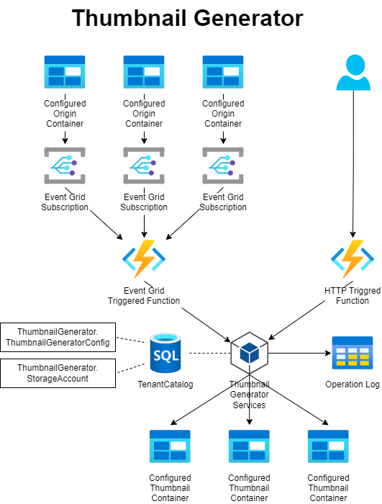
Architecture

Slide 27
Process
Blob added to subscribed container/path
Blob deleted from subscribed container/path
Resizable
Image
Type?
Resizable
Image
Type?
Log the error
Log the error
Config in
Database?
Config in
Database?
Create the thumbnail using configuration
Delete the previously created thumbnail
Log the action
Log the action
Done
Done

Slide 28

Solution Walkthrough
Automation Using Azure Event Grid

Slide 29
Thank You!
chadgreen@chadgreen.com
TaleLearnCode
ChadGreen.com
ChadGreen & TaleLearnCode
ChadwickEGreen

